Slide 1

Locating microseismic events:
A Physical Modeling Comparison Using P and S waves in Surface and Borehole Data
Omer Akbas
Department of Atmospheric and Earth Sciences
University of Houston
16 May 2013
Thursday

Slide 2

Questions to address
How the algorithm works?
Can S-waves be helpful besides P-waves?
How borehole receivers affect location uncertainty?
Can amplitude be used apart from traveltimes?
How do multi-component receivers help us locate events?
Can we make it run faster with parallel computing?

Slide 3
Microseismicity tells us about the induced fractures...
Location
Length
Height
Growth
Orientation
Fractures
Complexity

Slide 4
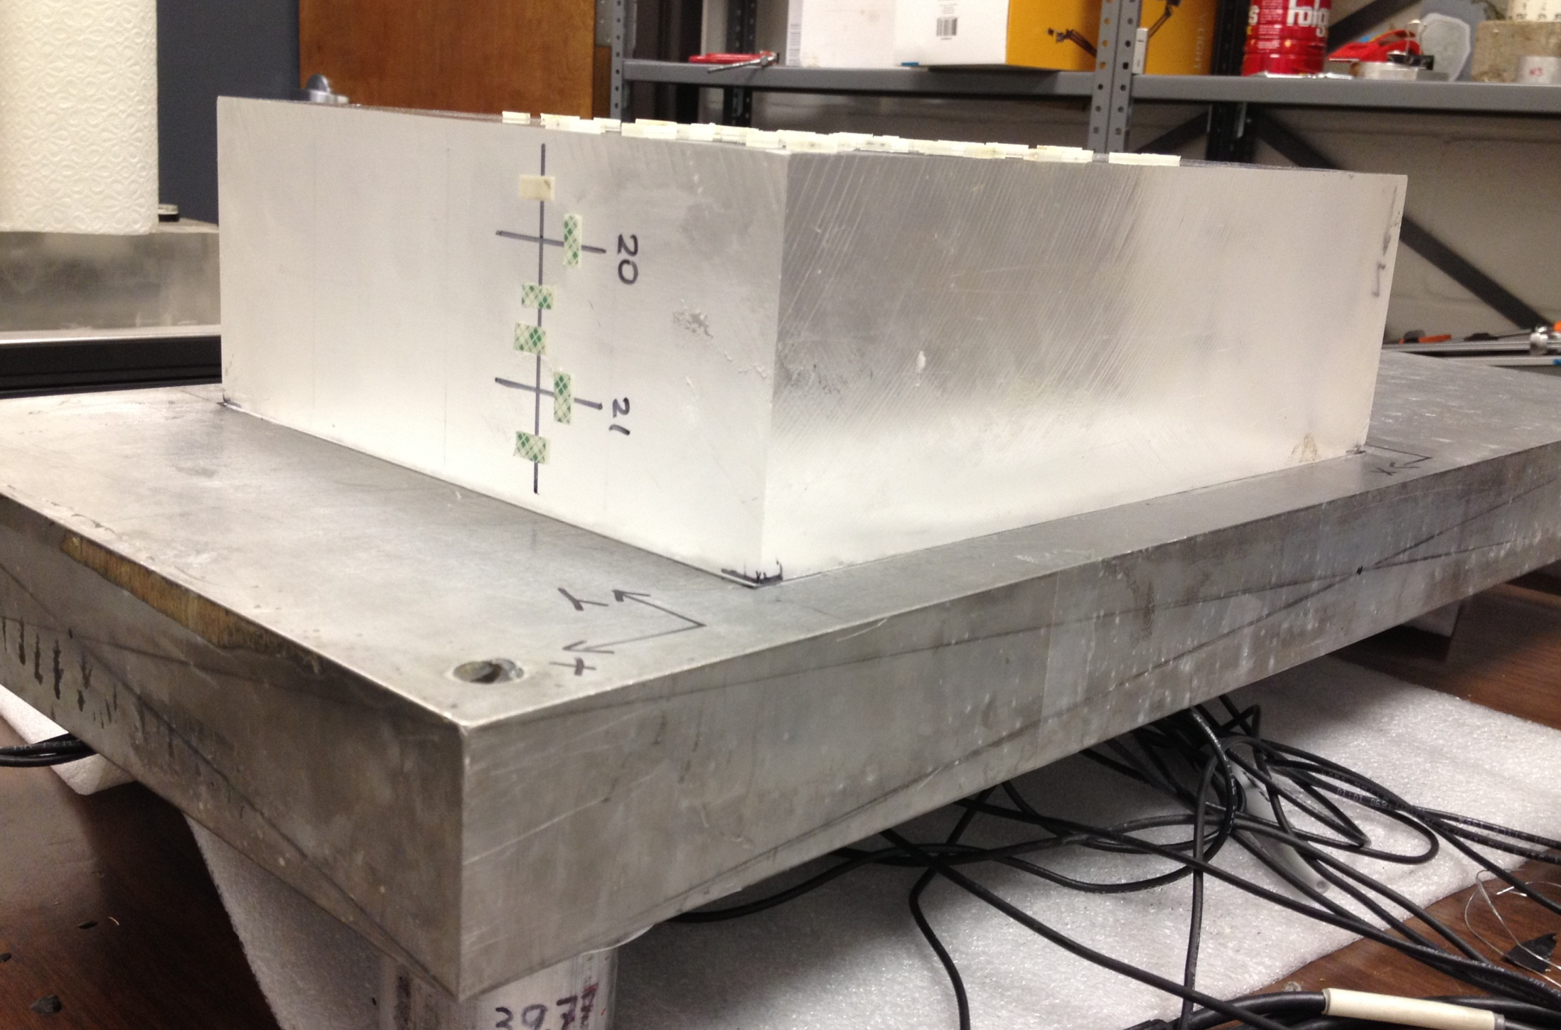
Physical Modeling – Data Acquisition
307.70 mm
93.9 mm
242.45 mm
50.7 mm

Slide 5
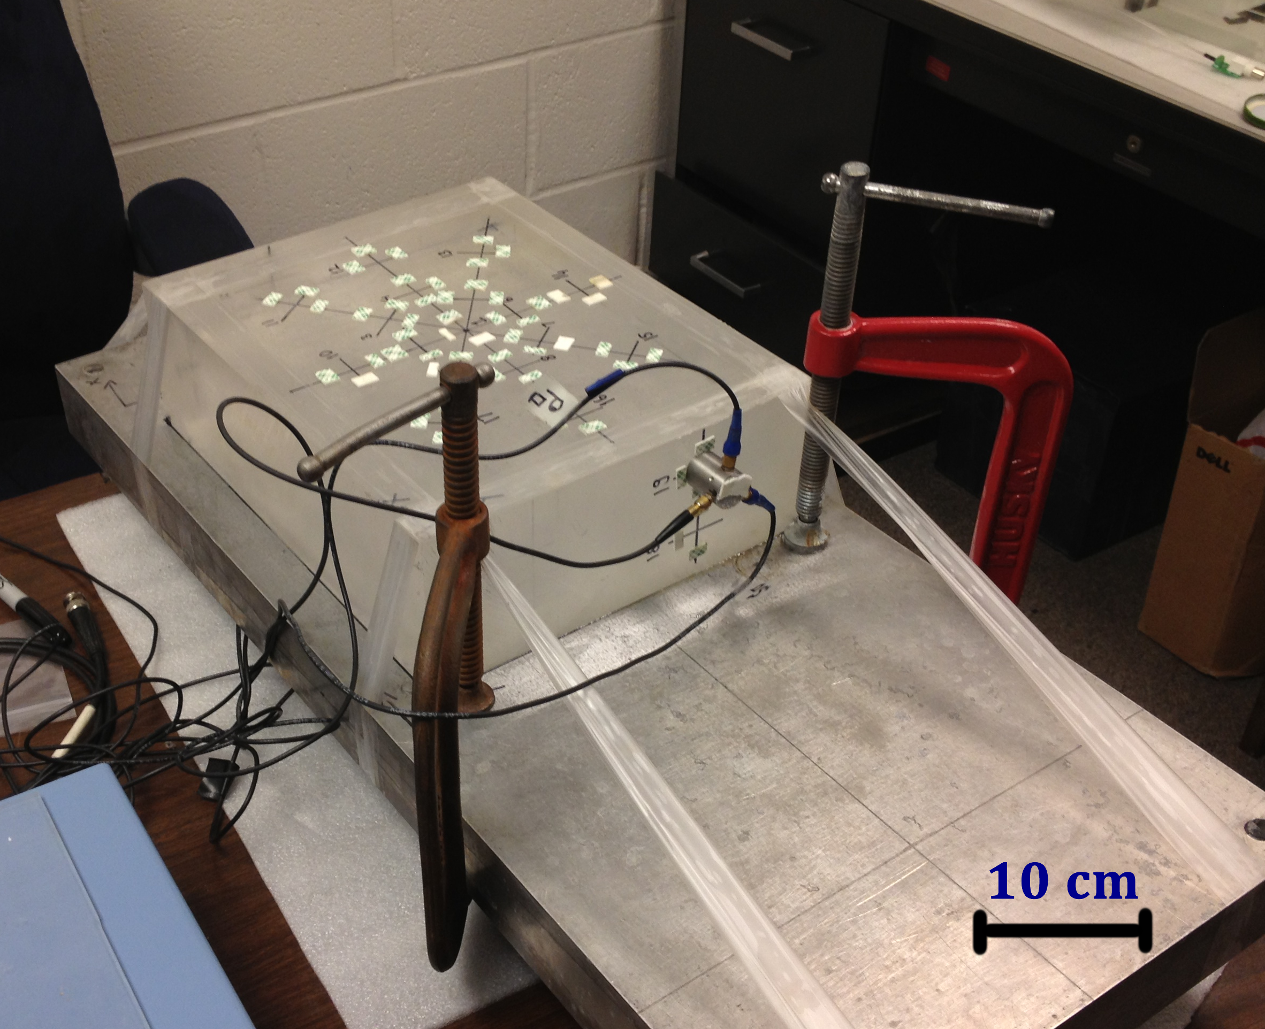
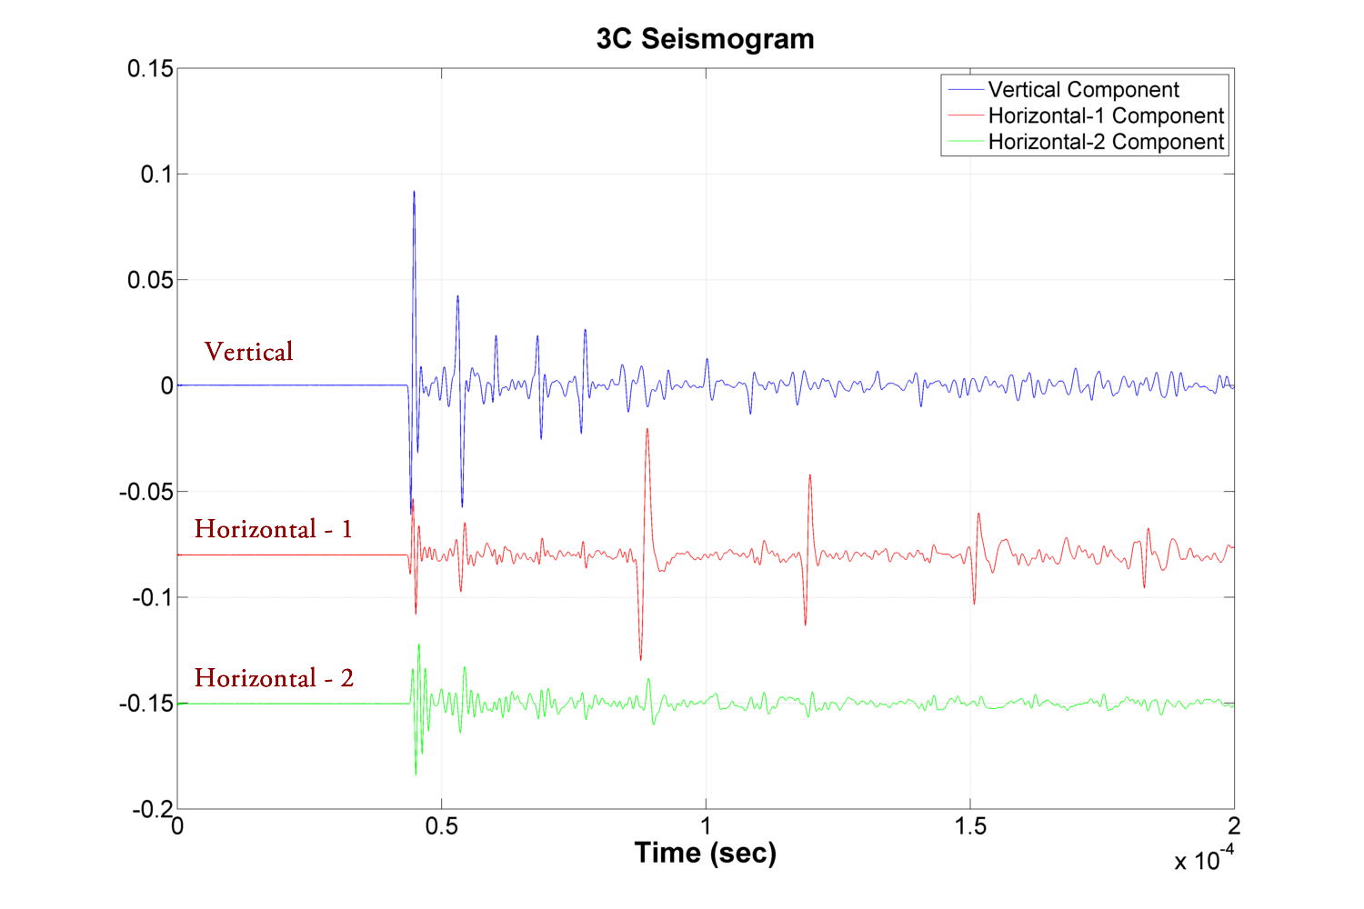
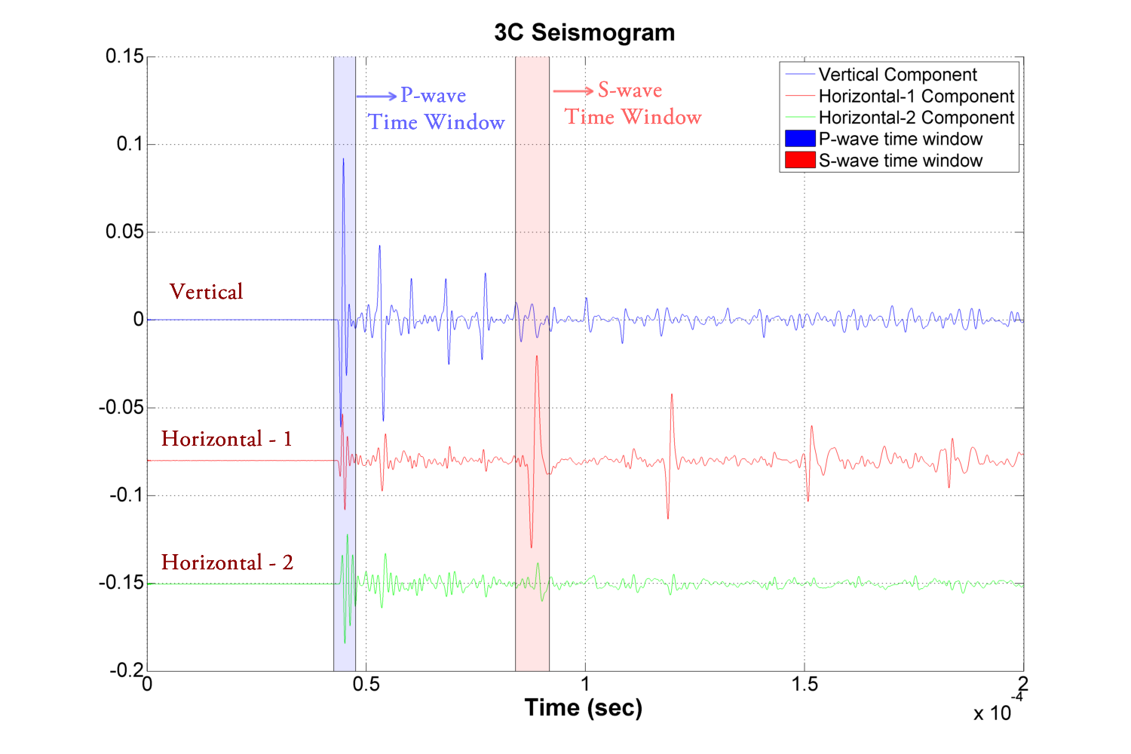
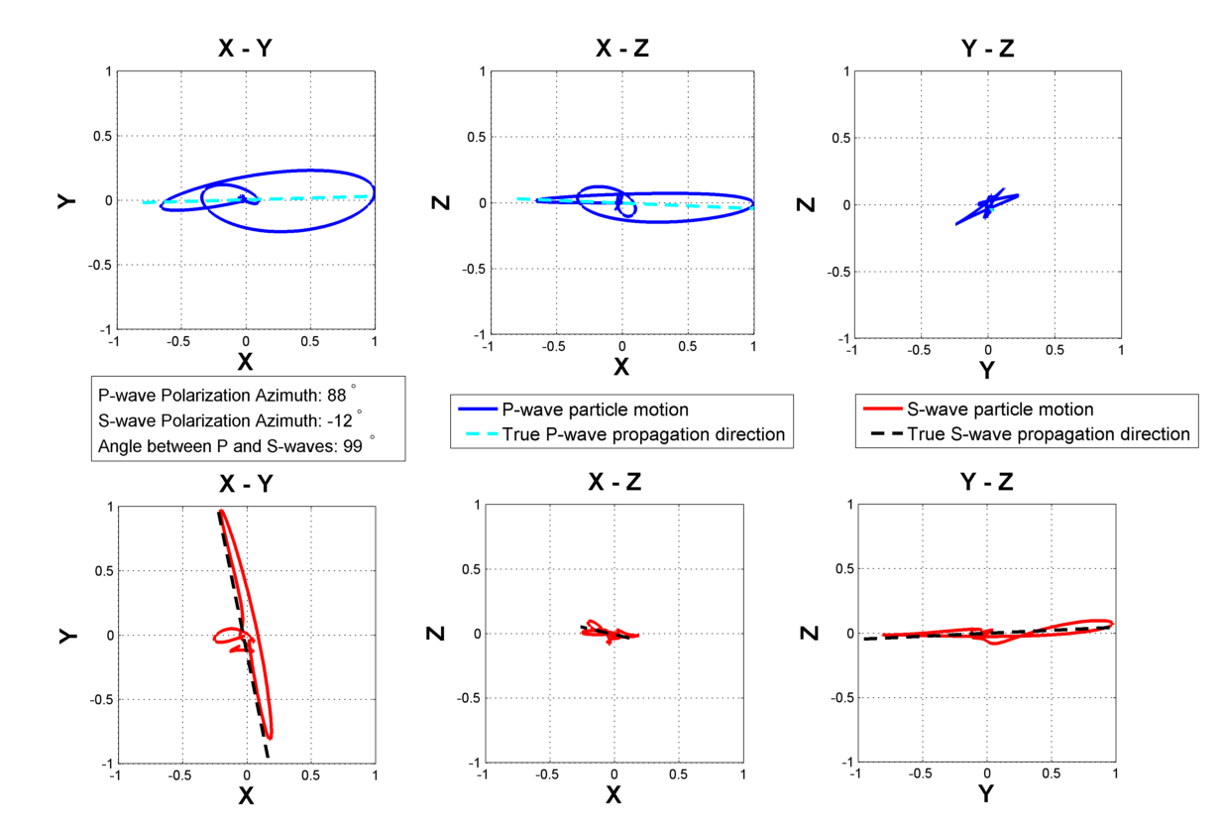
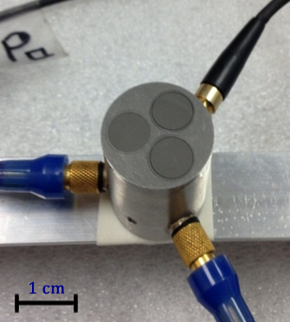

Slide 6

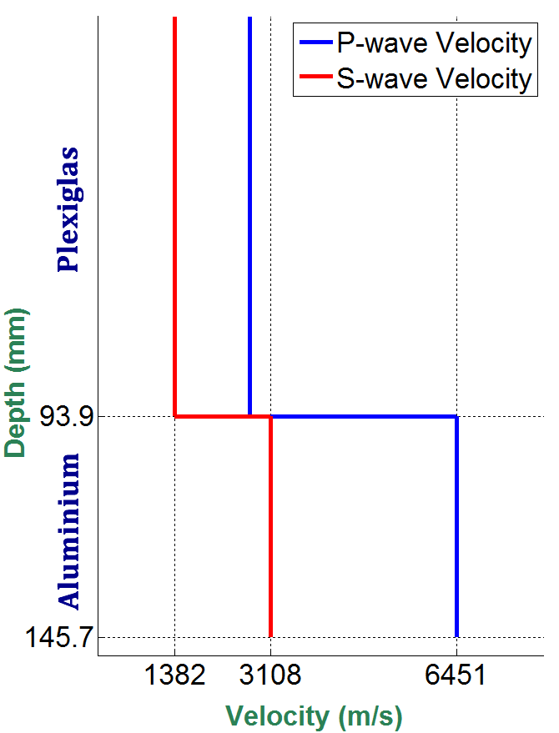
Velocity Measurements
 | P-Wave Velocity (m/s) | S-Wave Velocity (m/s)
Plexiglas | 2720 | 1382
Aluminum | 6451 | 3108

Slide 7
Location Algorithm:
How it works?
Locating events
Traveltime residual
Amplitudes
Amplitude/Traveltime Ratio

Slide 8



Locating Events:
via traveltimes

Slide 9
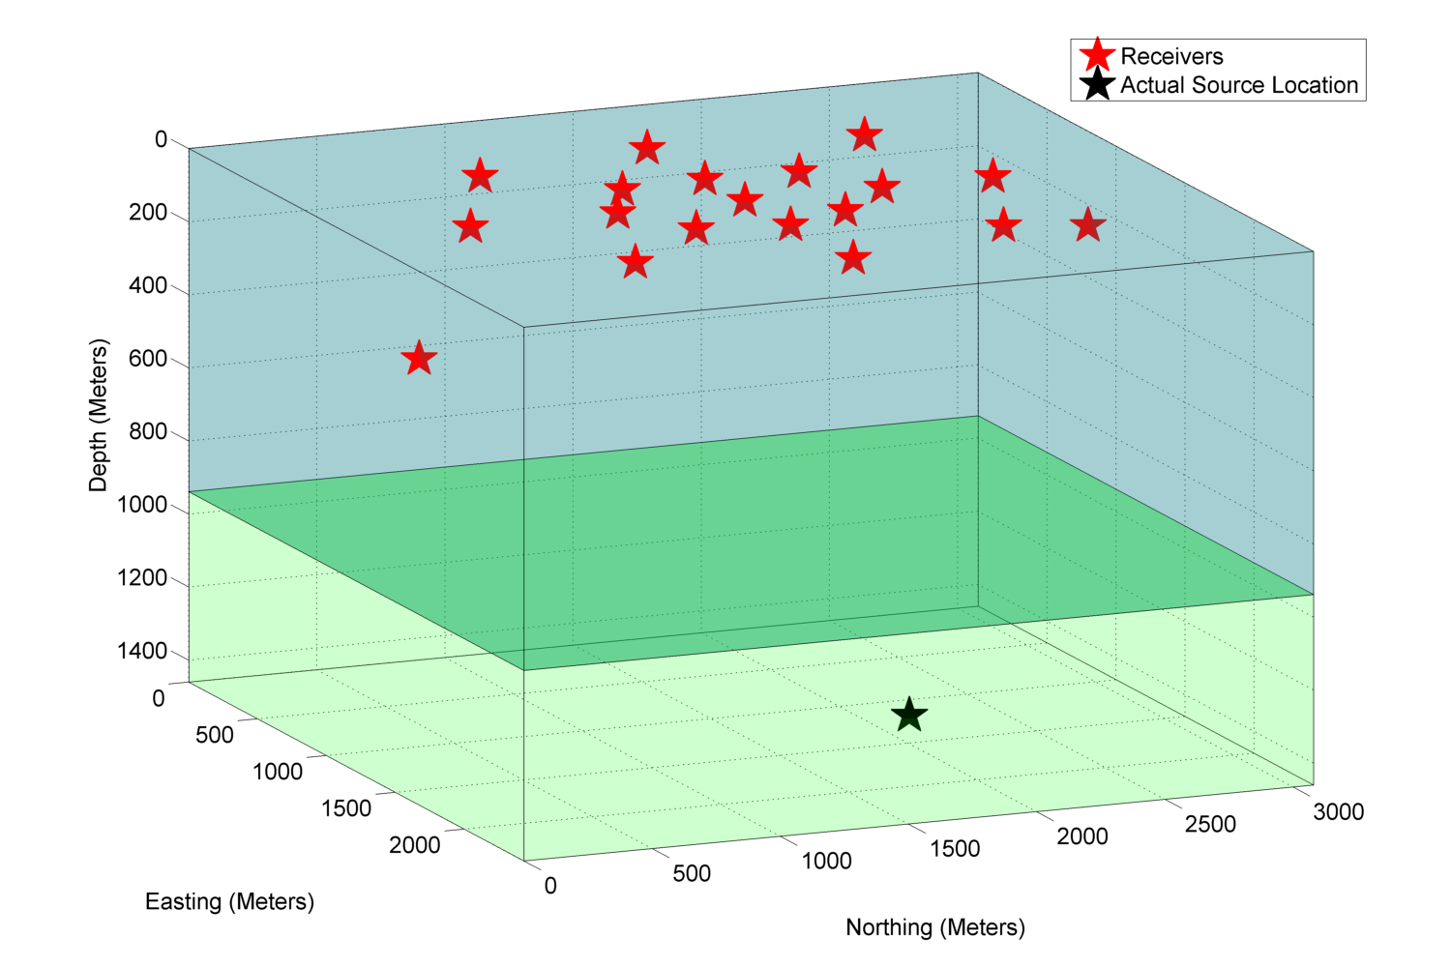
3D View of the Model

Slide 10
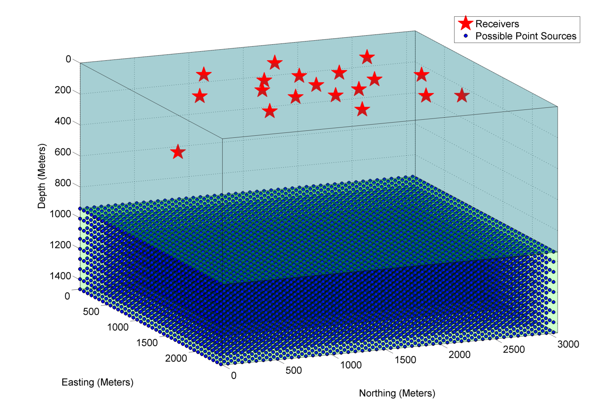
Create a grid area
Dense grid interval –» More accurate but slow
Coarse grid interval –» Less accurate but faster
To achieve fast and accurate solution:
collapsing grid algorithm is implemented.

Slide 11
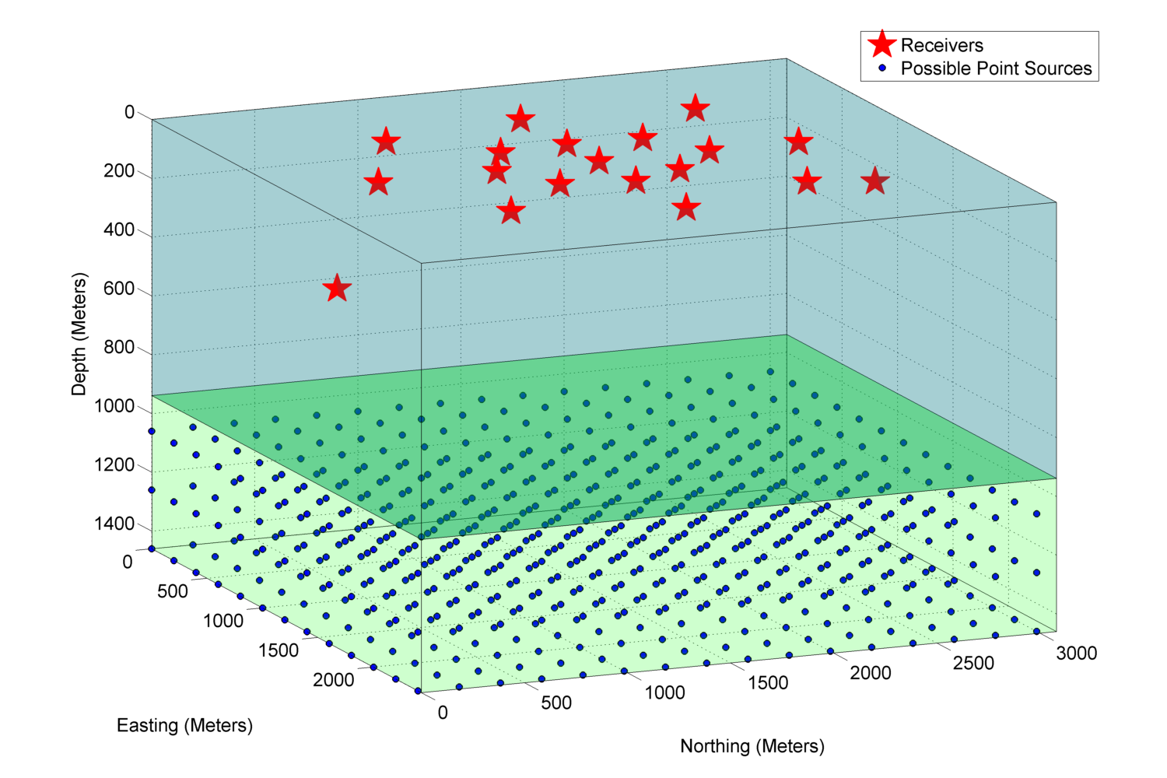
Step 1: Create grid area with coarse spacing
Search starts with coarse grid spacing (200 meters)

Slide 12
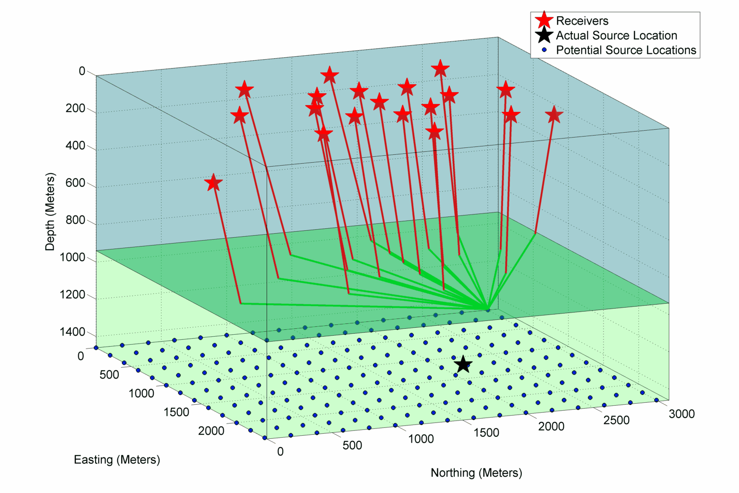
Step 2: Calculate synthetic traveltimes
Traveltimes are calculated via ray tracing for each potential source location

Slide 13
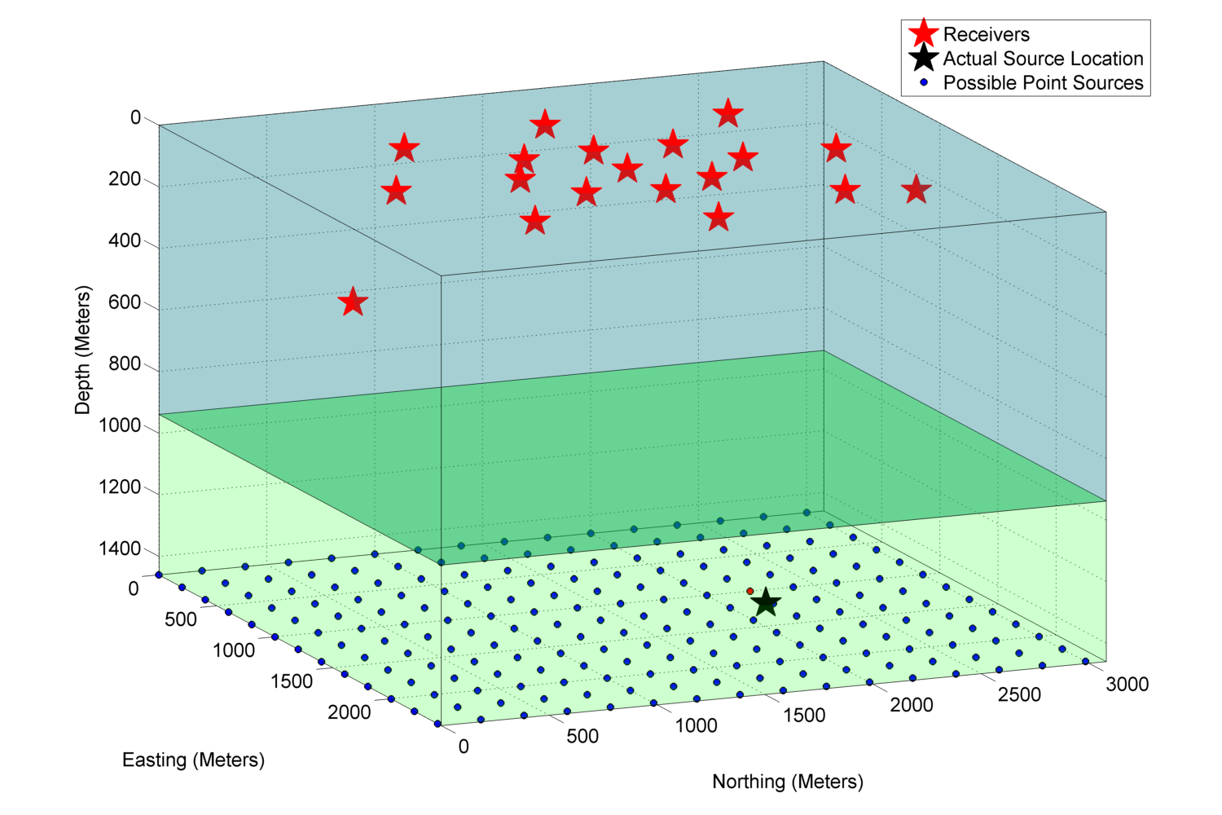
Step 3: Compute the traveltime residuals
Approximate source location is found with a coarse grid spacing

Slide 14
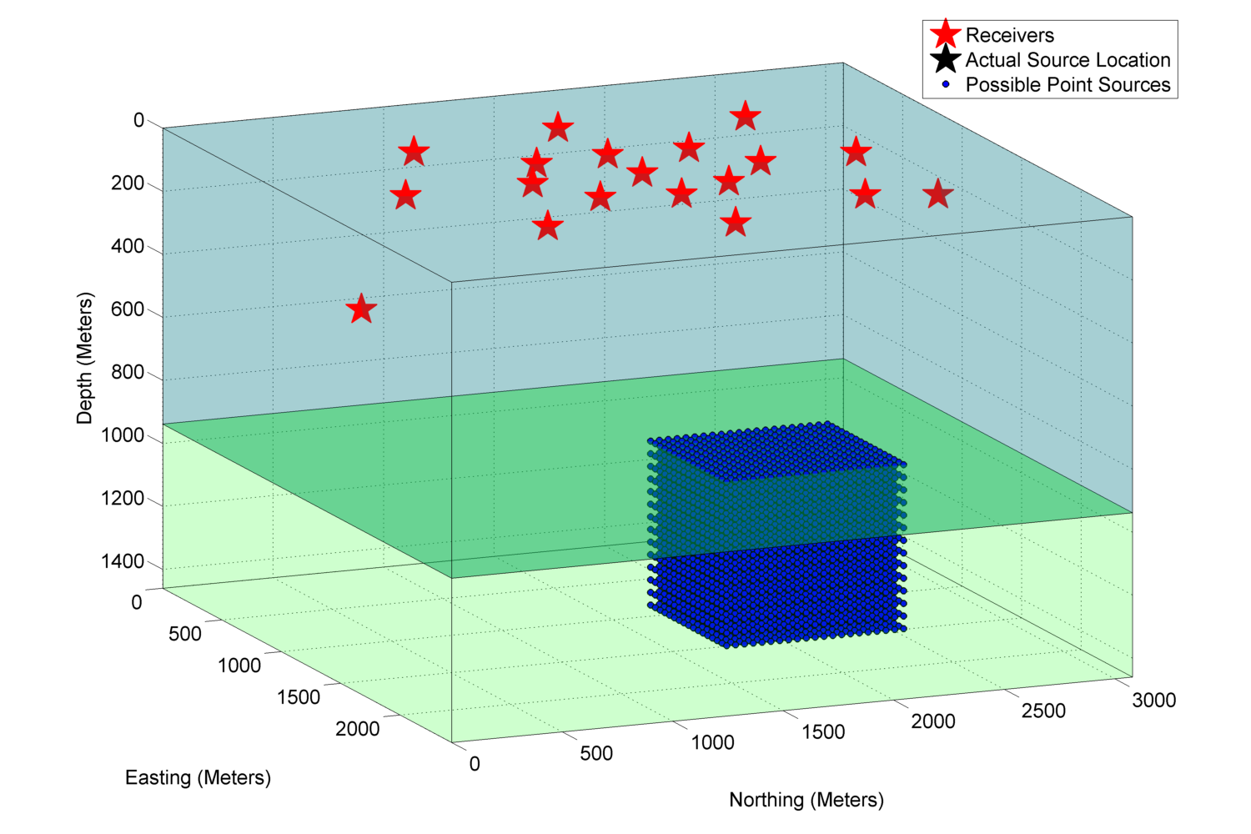
Step 4: Create another grid area with dense grid spacing

Slide 15
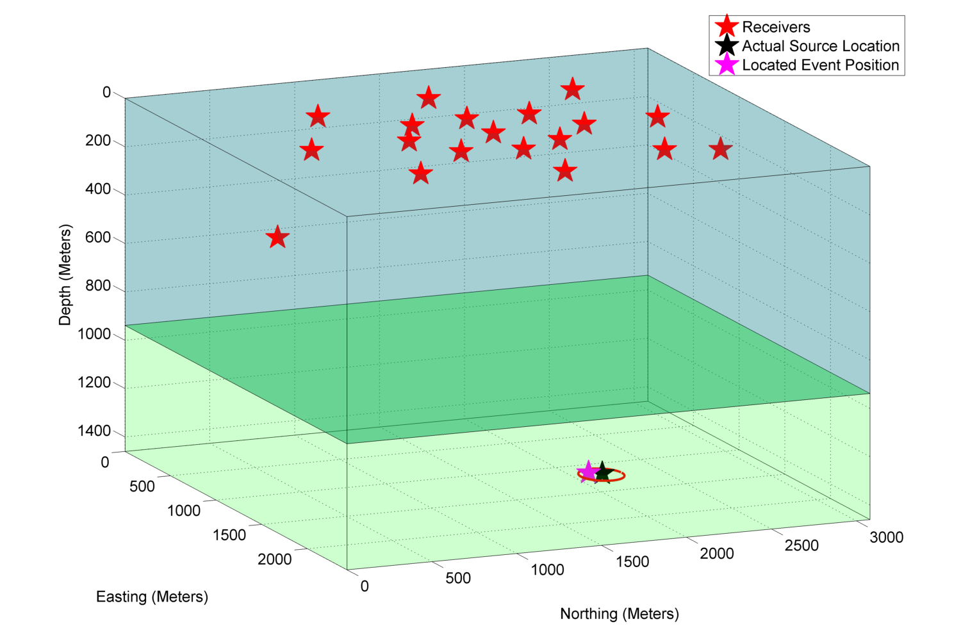
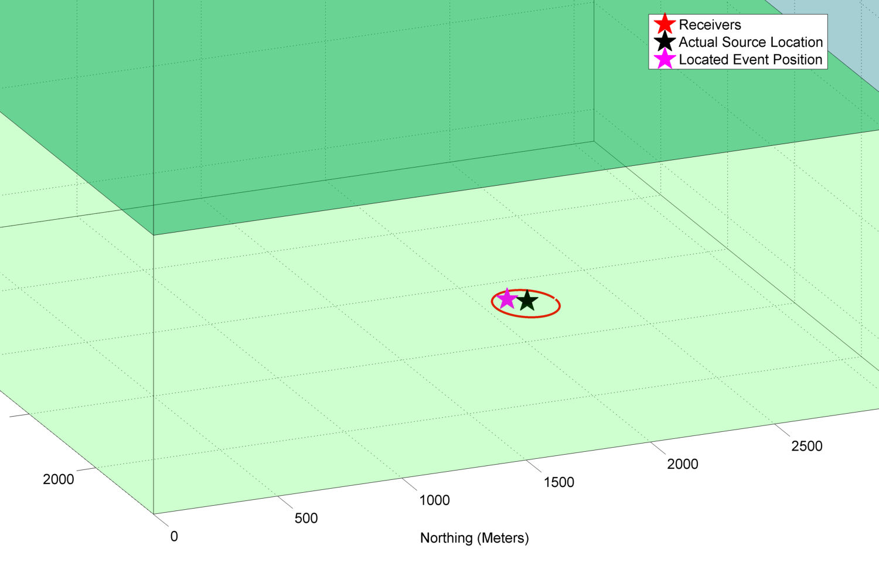
Step 5: Pick the location minimizes the traveltime residual
Corresponds to area of source transducer
Source coordinates are located after second iteration

Slide 16
Locating Events: via amplitudes

Slide 17



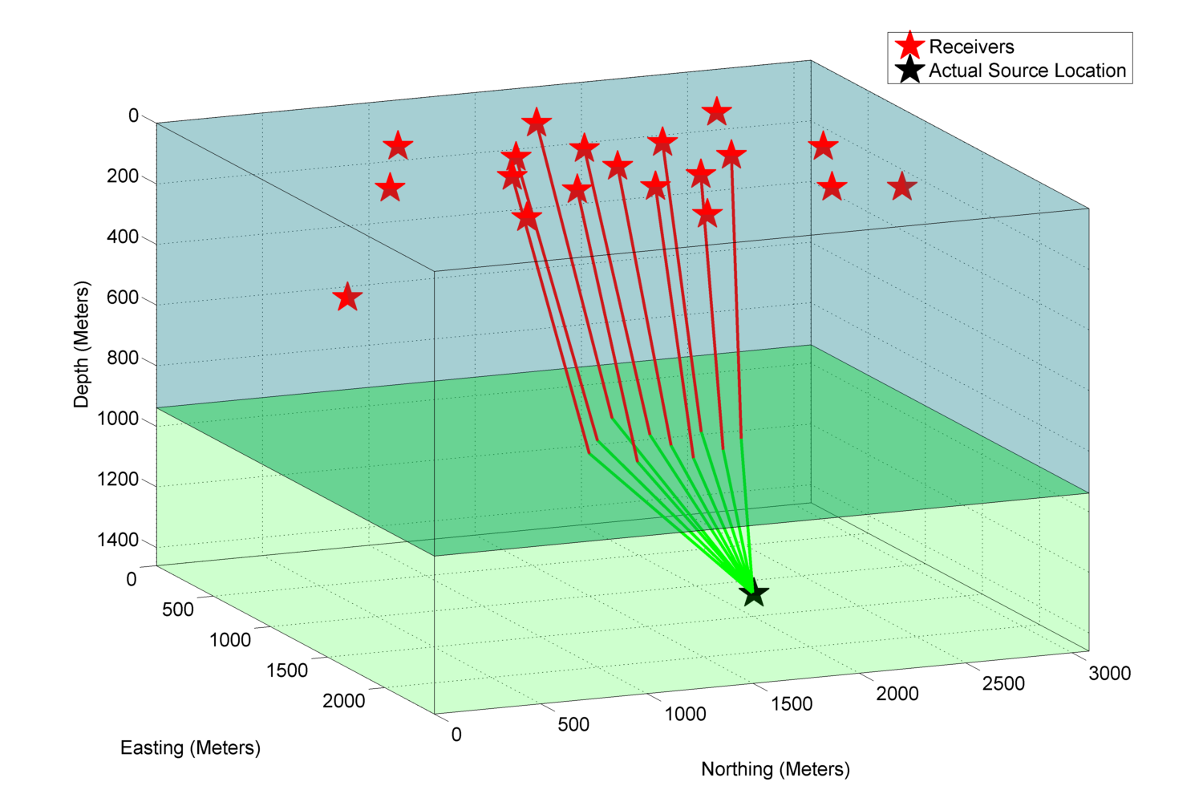
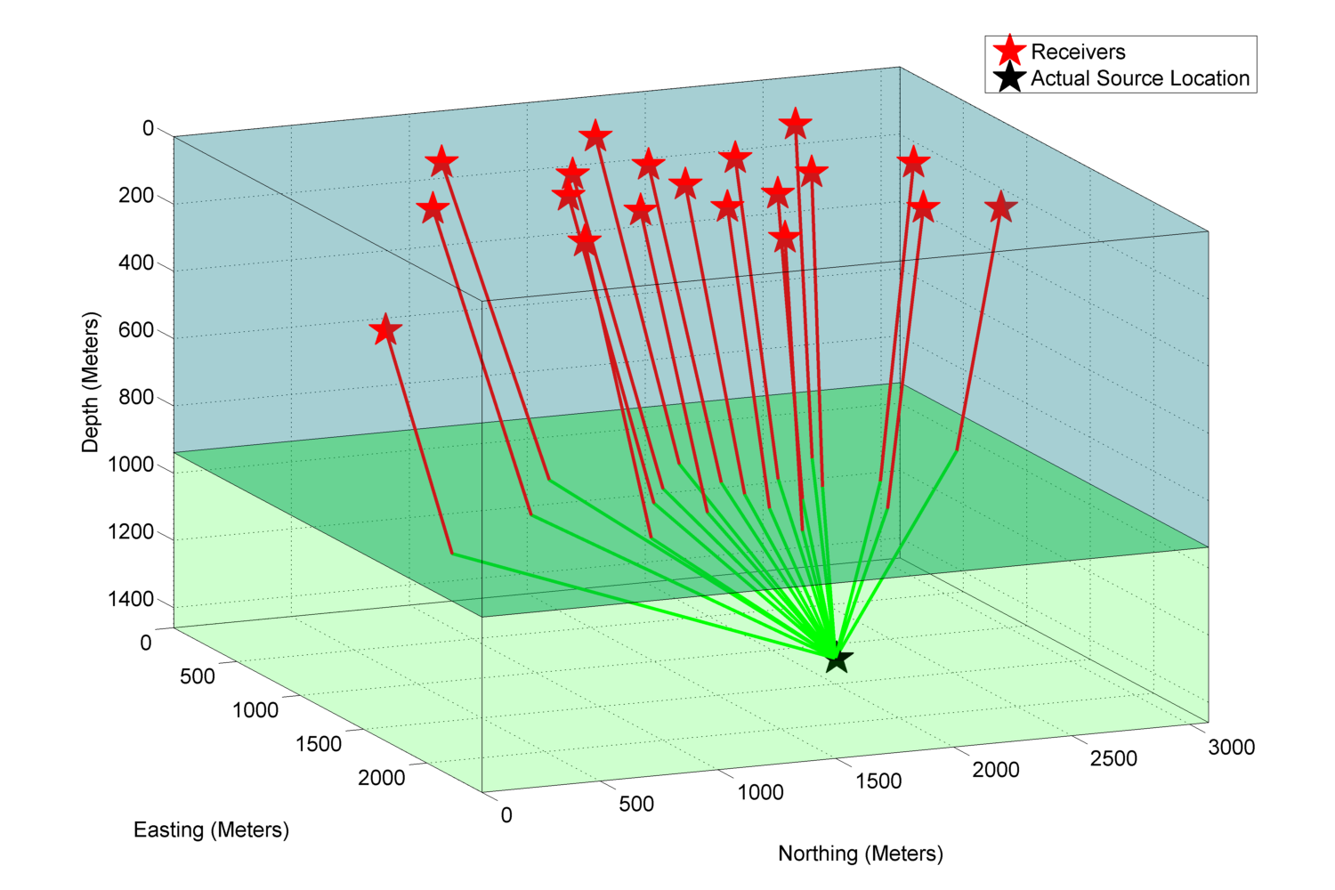
Generating Stacked Energy Contour Map
For each potential source location, we have:
(X-Y-Z) coordinates
A stacked amplitude value
Total Traveltime:
0.044 ms

Slide 18
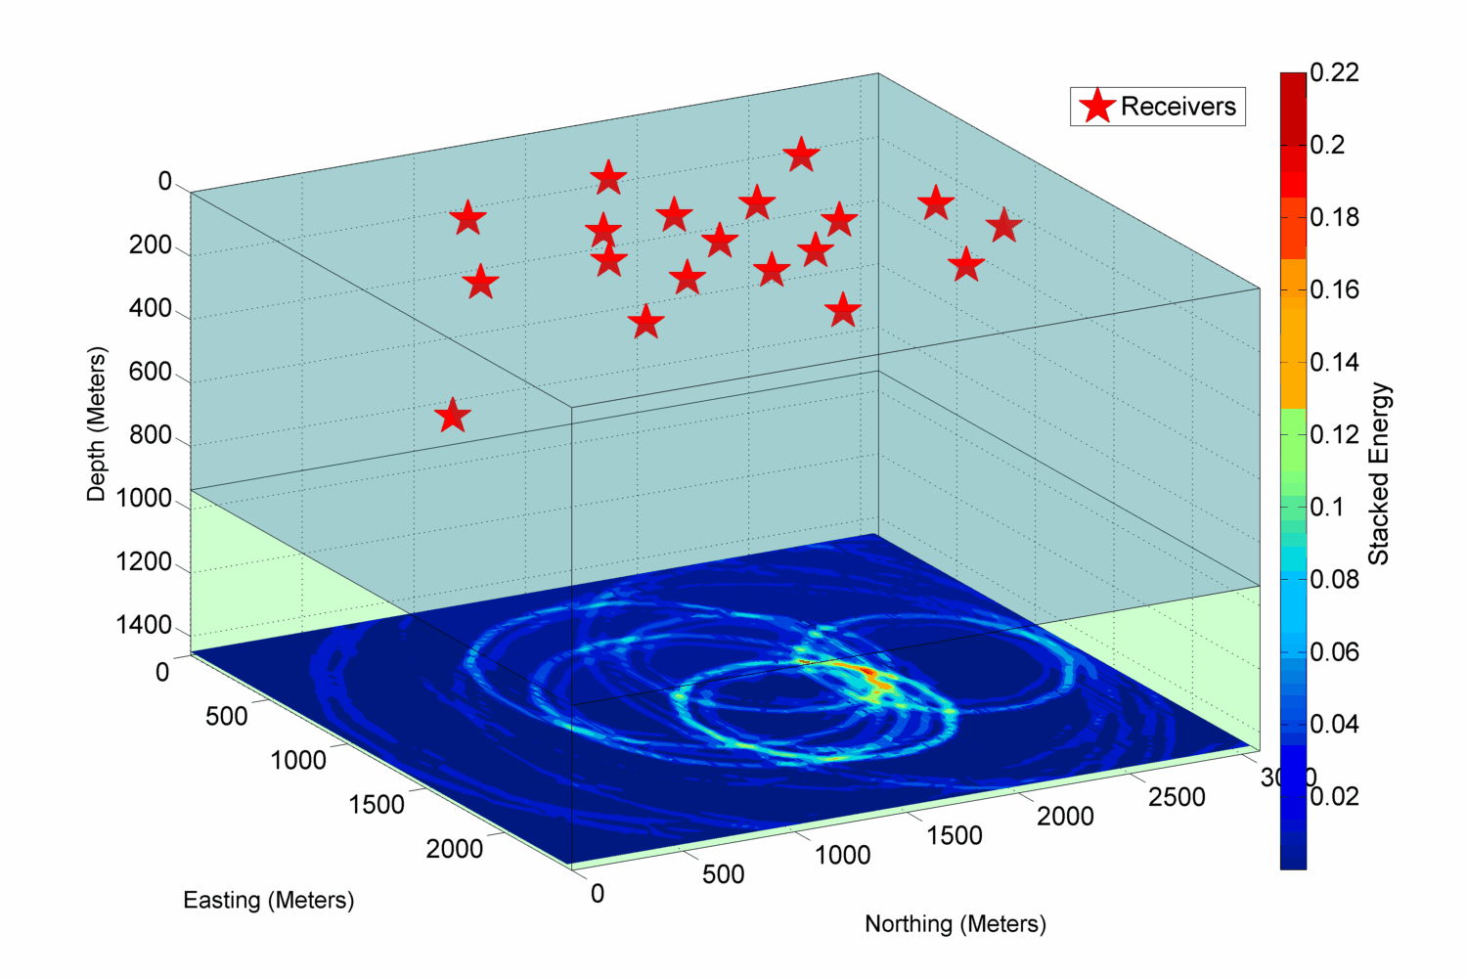
Stacked Energy Contour Map

Slide 19
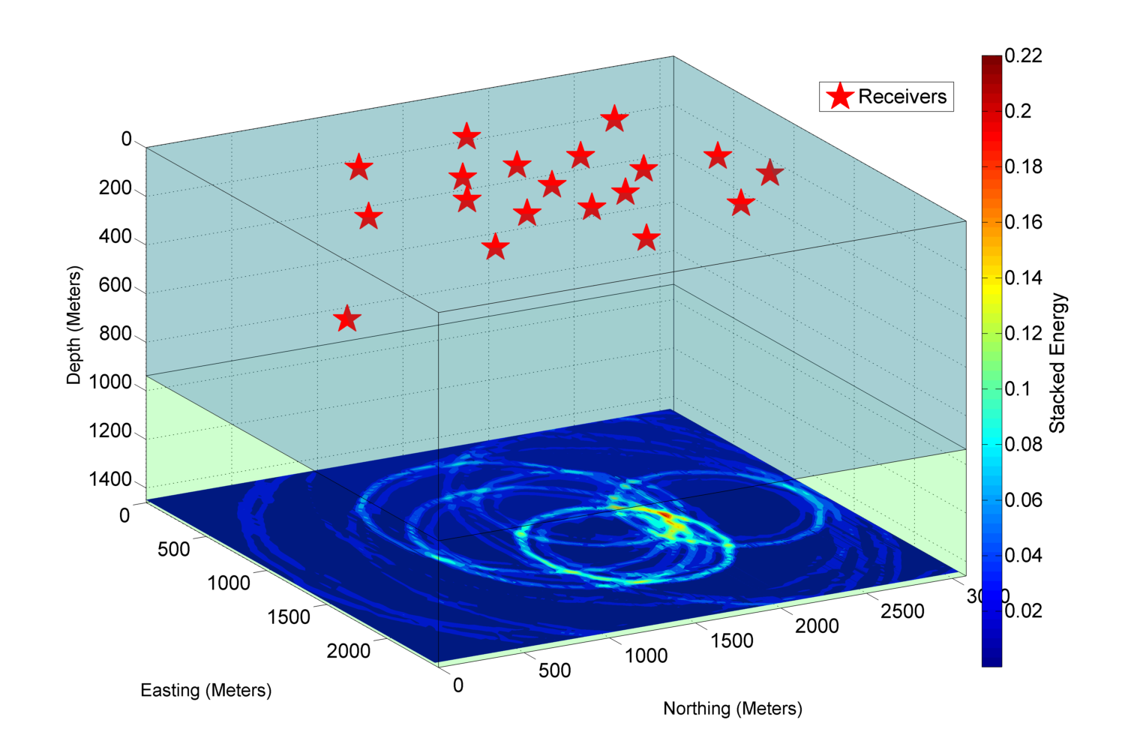
Slice at Z=1450 meters
Higher amplitude values are more likely to be the source location

Slide 20
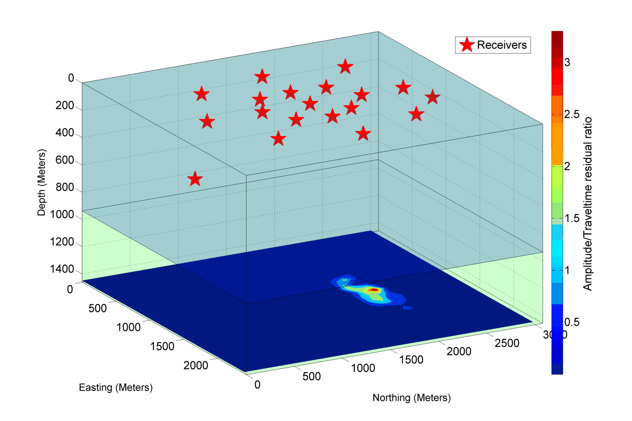
Amplitude/Traveltime ratio contour map

Slide 21
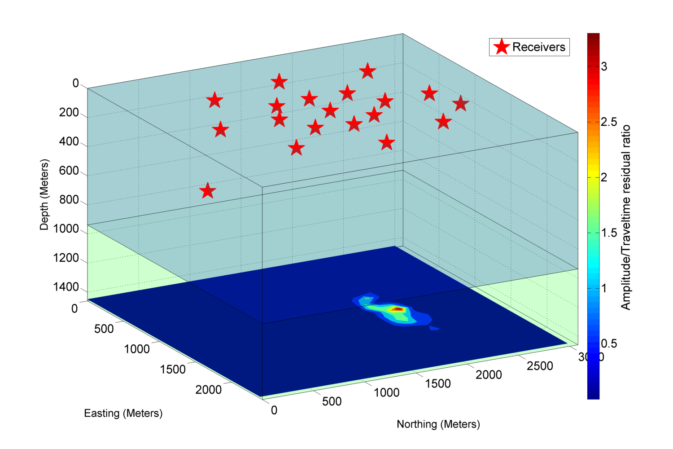
Slice at Z=1450 meters
The Apex of the ratio corresponds to source location

Slide 22
More Experiments Results
Approach | Coordinates (X,Y,Z) | RMS Error
Actual Source Position | 2160, 1200,1450 | -
P-wave & All Receivers | 2190, 1170,1450 | 0.17µs
P-wave & Excluding downhole | 2120, 1240,1450 | 0.31µs
S-wave & All Receivers | 2240, 1260,1430 | 1.14µs
S-wave & Excluding downhole | 2090, 1280,1410 | 1.32µs

Slide 23
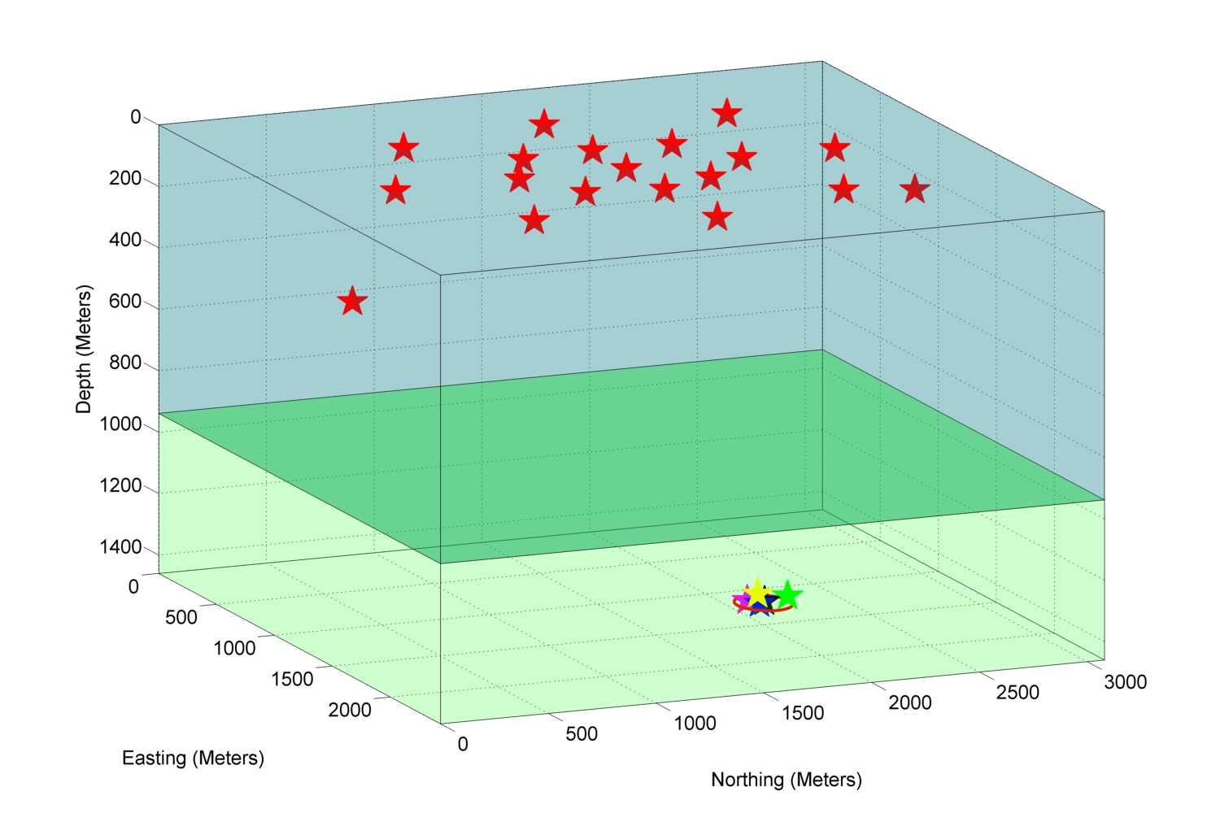
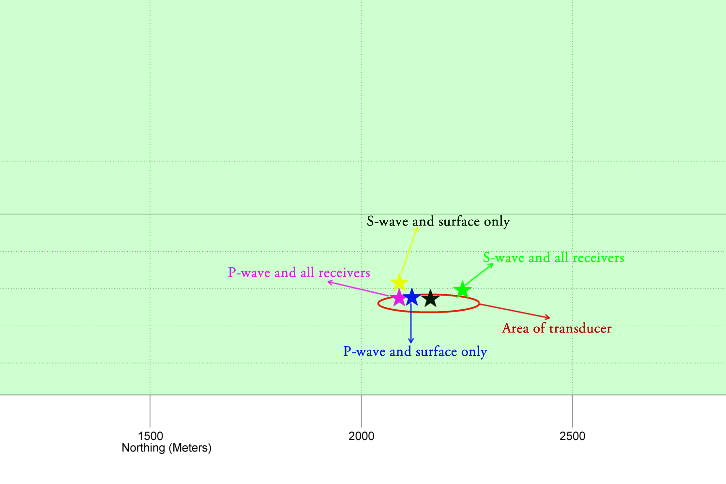
Comparison of the results

Slide 24
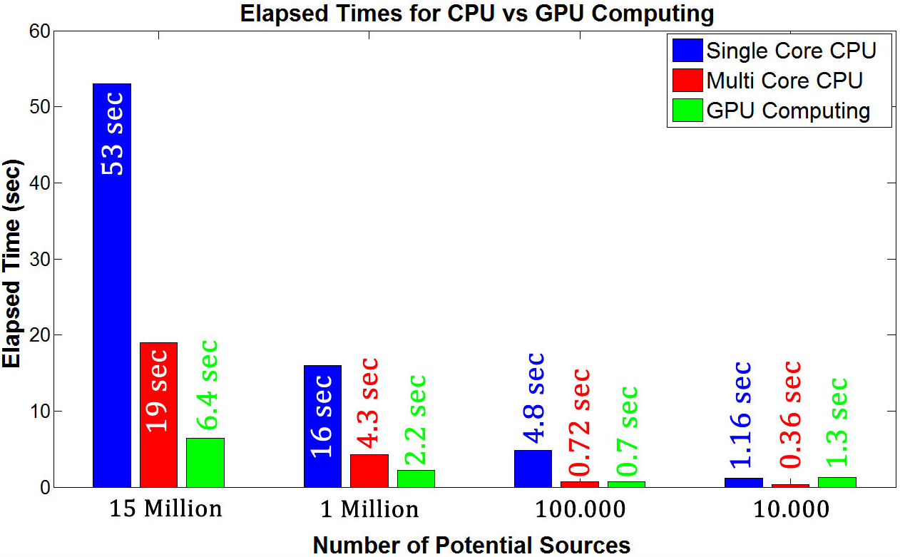
Optimizing the Algorithm
CPU : AMD Phenom X6 1055T @3.3 GHz
GPU: NVidia GeForce GTX 460 1GB; @850 MHz
RAM: 8 GB RAM @1600MHz,

Slide 25
Conclusion
How the algorithm works?
  It is based on grid searching technique; also it uses collapsing grid algorithm.
Can amplitude be used apart from traveltime residuals?
  Yes, amplitude can be used to locate events. Amplitude/traveltime ratio is less noisy.
Can S-waves be helpful besides P-waves?
  Yes, we are able to locate events with using only S-waves.
How borehole receivers affect location uncertainty?
  Excluding well-side receivers increases RMS error.
Any help of using 3-C receivers?
  Allows us to compute polarization of P and S-waves.
Can we make it run faster with parallel computing?
  Yes, we can. Significant increase in performance is observed with GPU computing.

Slide 26
Future Works
More complex physical models will be tested.
Numerical dataset will be generated by using elastic finite-difference method to test the algorithm.
Polarization information can be used in a way to locate events.
Focal mechanism and radiation pattern determination.

Slide 27
Acknowledgements
Dr. Robert Stewart
Dr. Nikolay Dyaur
Allied Geophysical Laboratories

Slide 28
END OF THE
SLIDES
Thanks for your attention

Slide 29
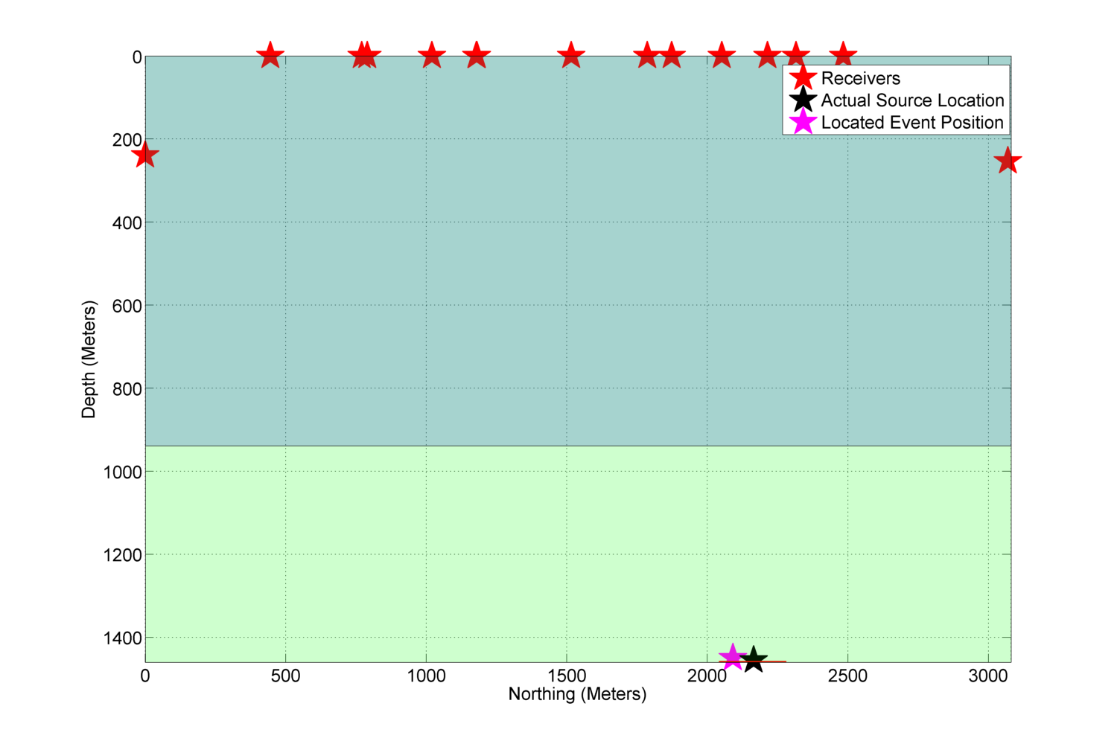
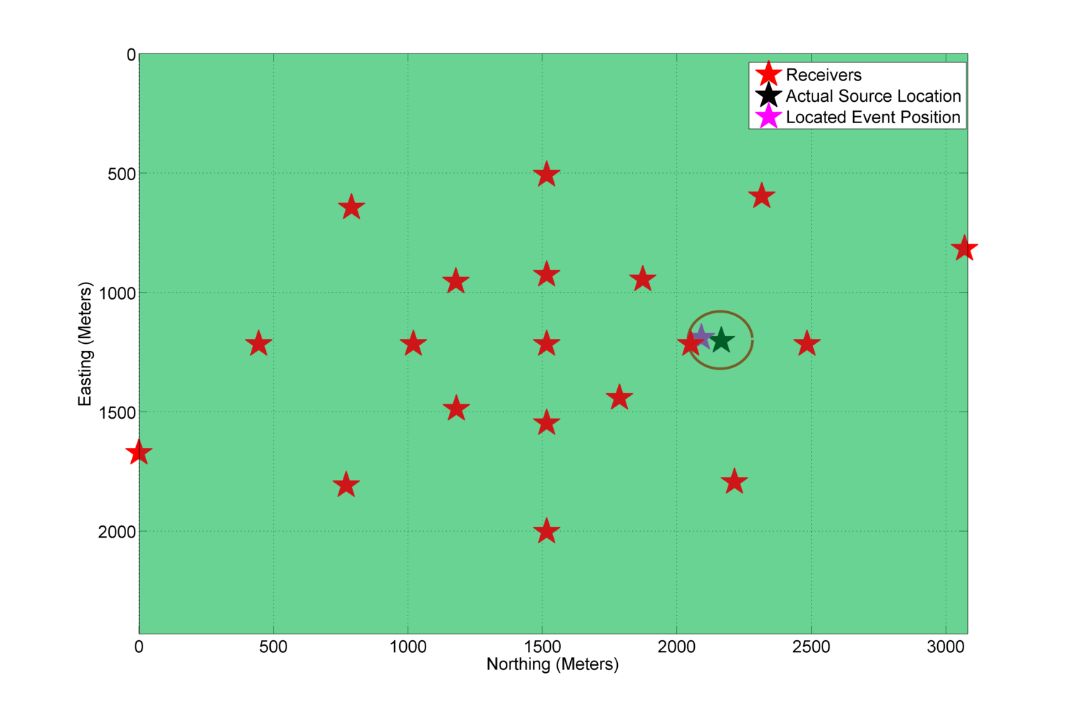
MapView of the Model
X-Z View of the Model

Slide 30
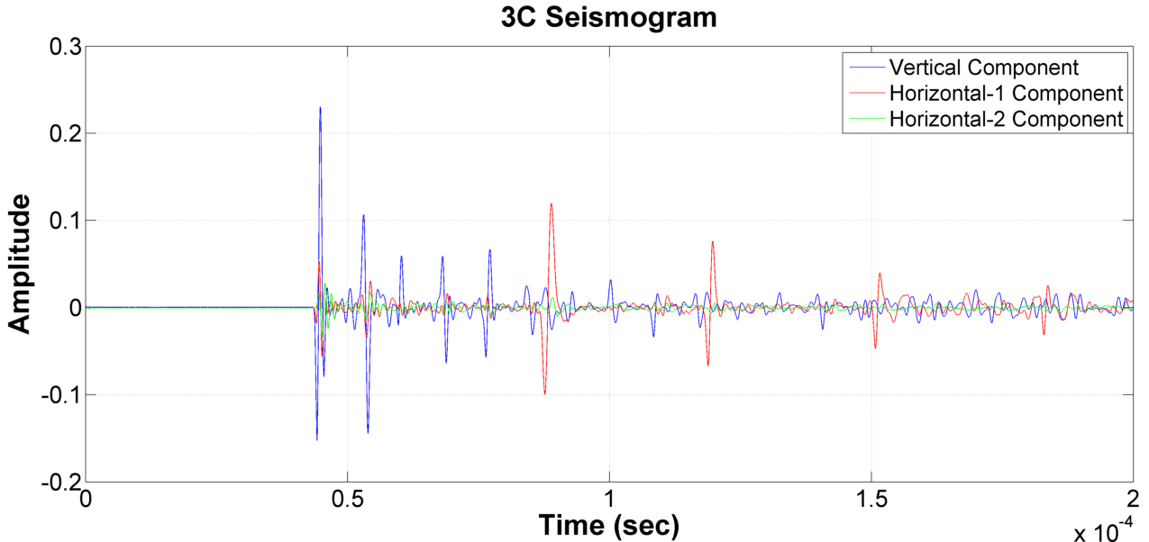
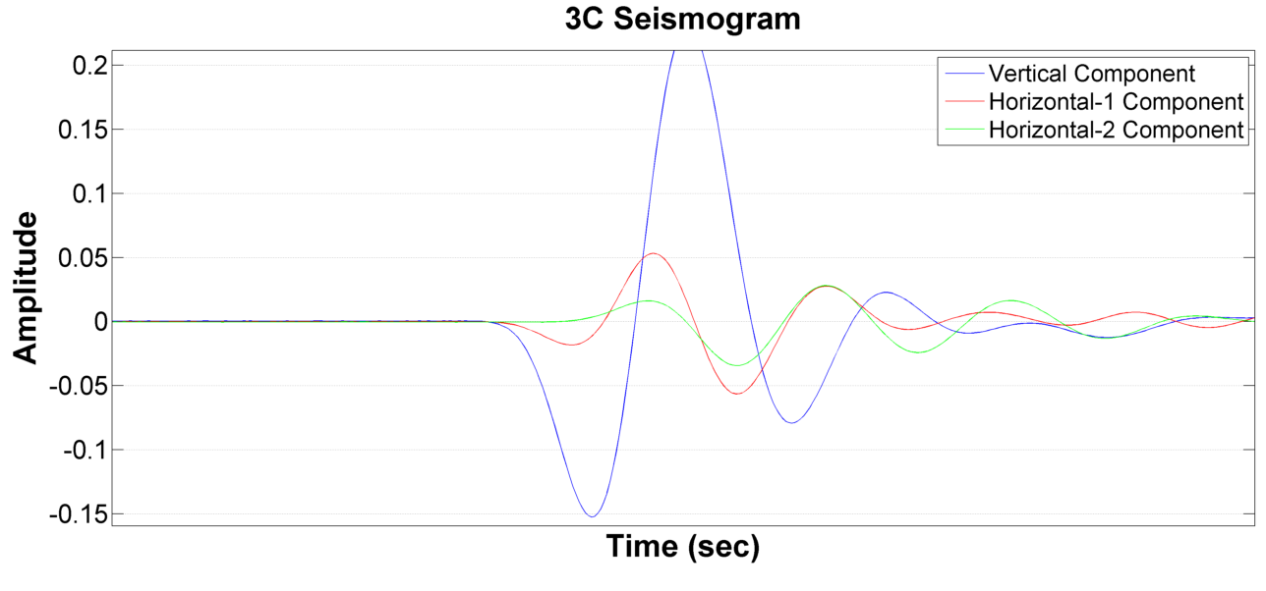
Generating Stacked Energy Contour Map
0.044 ms
Total Traveltime:
0.044 ms

Slide 31
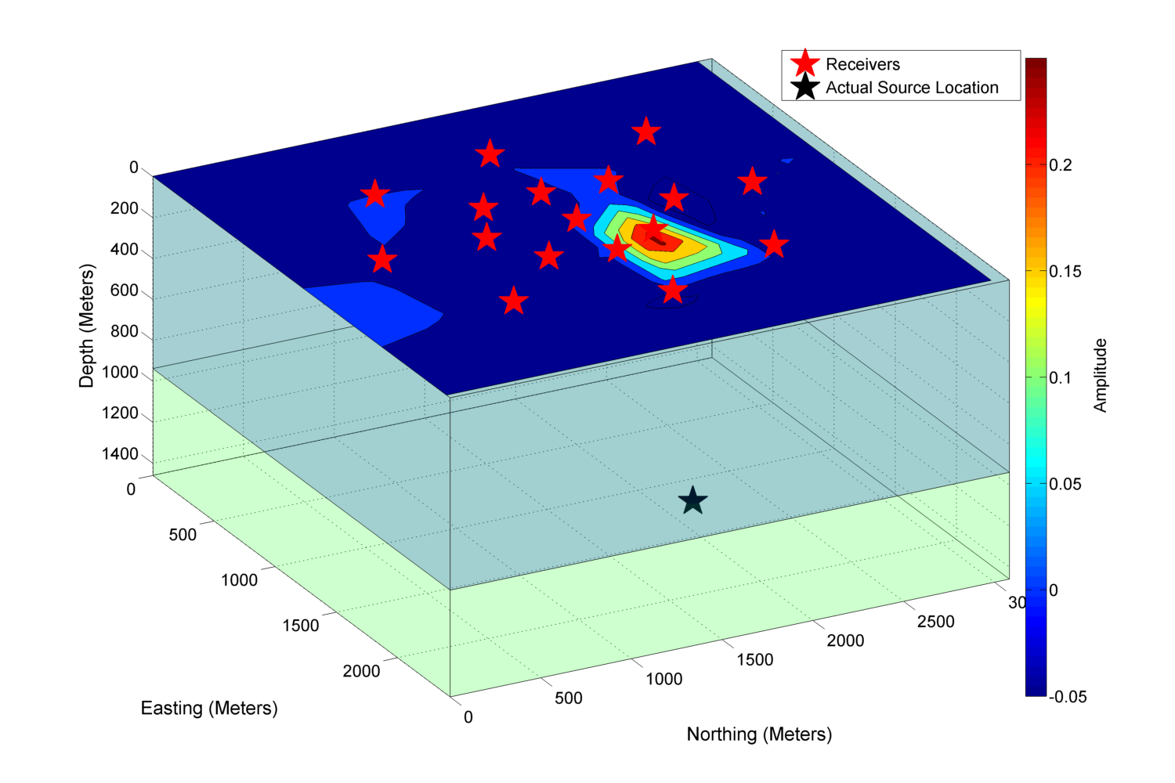
Radiation Patterns

